Slide 1


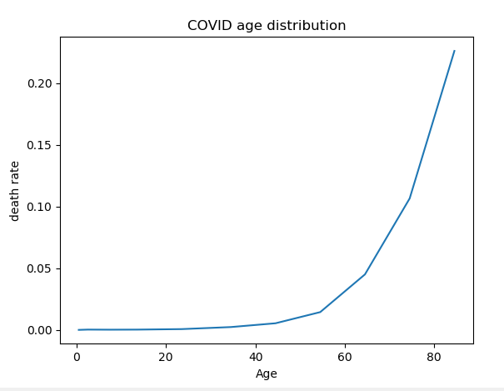
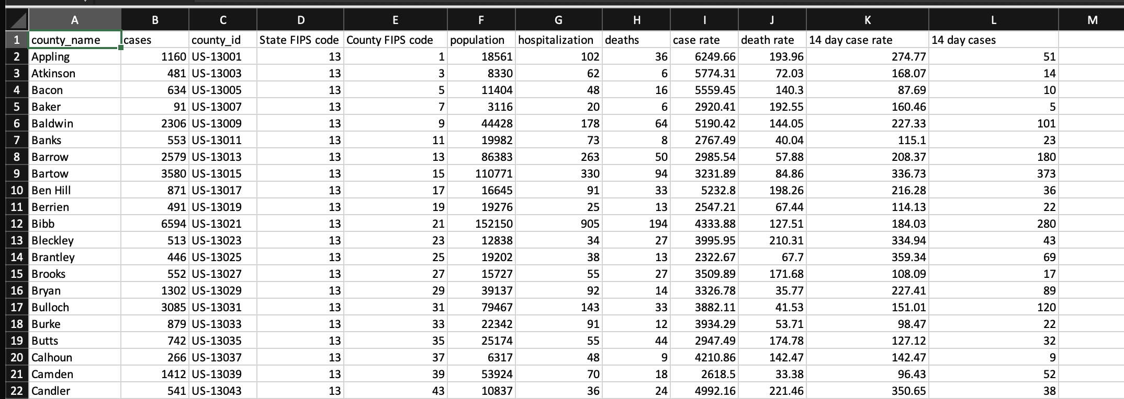
Silent Space Titanic Pythons
Our Data: COVID-19 cases and deaths by county
Source: Georgia Dept of Public Health
https://dph.georgia.gov/covid-19-daily-status-report.
Why we need the data:
We need to use the dataset to document the distribution of COVID-19 cases and deaths by county in Georgia, USA.
How we will use it:
We intend to model the spread of the virus among communities that have been economically or otherwise impacted and to demonstrate the rate of fatality amongst these communities. We will set up a Google Cloud environment and we will visualize the data using Jupyter Dash.

